Slide 1
Data Modeling Concepts Part 3
<Data Model 101 Series>
Anand Kumar
Notes:
Hi. This is the part 3 of the Data modeling concepts series of presentations. From part 1 and part 2 of this series, you must have garnered good knowledge on what a data model is, its constructs, its types and more. In the following slides, we shall learn more on the established notations and its usage in the data warehousing field.
© 2009 Wipro Ltd – Internal & Restricted
‹#›

Slide 2
Data Modeling Overview
A method by which the enterprise business model is defined in terms of data elements and the relationships existing among those data elements.
Provides data view of the business model in a graphical representation of data elements as entity sets and business rules as relationships lines connecting the entity sets.
The data modeling details are covered in three parts,
Part 1 – Introduction to Database System and Context of Data Modeling.
Part 2 & 3 - Data Modeling terms and concepts and Data Modeling in Data Warehouse environment.

Slide 3
Data Modeling Objectives
Upon completion of this module you will be able to:
Familiarize with terms and concepts of Data Modeling
What Data Model is used in Data Warehouse

Slide 4
Data Modeling Outline
Lesson 1 Data Modeling – Terms and Concepts
Lesson 2 Data Modeling In Data Warehouse

Slide 5
Data Modeling – Terms & Concepts
Primary Key, Relationship, Foreign Key

Slide 6
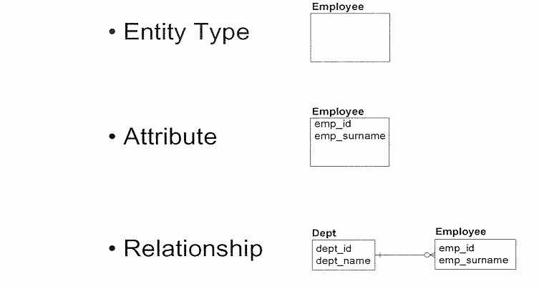
Basic Constructs
A data model is composed of three basic constructs: entity types, attributes and relationships.

Slide 7
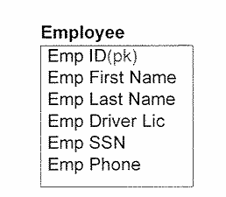
Primary Key
A primary key uniquely distinguishes one occurrence of an entity type from another.
A primary key consists of one or more identifying attributes, each of which is labeled as “(pk)”.

Slide 8
Rules for Primary Key
Each entity type must have only one primary key.
The value of a primary key must correspond to one and only one occurrence of the entity type.
A primary key consists of one or more identifying attributes, each of which must always be present.

Slide 9
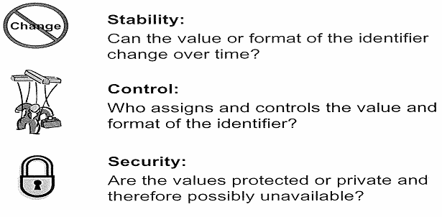
Primary Key – Logical Considerations
When deciding which attribute should be used as an identifier, three mail factors should be considered:
Stability – Identifying values should be stable and should never change once they have been assigned.
Control – Externally–controlled values could possibly change over time (e.g. zip code, social security number, etc.). While they can be used, it is best to avoid using these values if possible with a few exceptions.
Security – It is best to use values that you can openly use and/or request (e.g. internally created numbers like Employee Id).

Slide 10
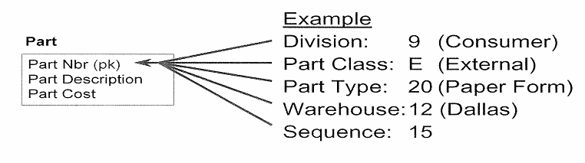
Smart Code – Definition & Example
A smart code is a single identifying attribute made up of multiple values.
For e.g. Part number 9E201215 can be defined as:
Division 9 - Consumer Services
Part Class E - Externally produced
Part type 20 - Paper Form
Warehouse 12 - Dallas
Sequence - 15
If the “intelligence” built into the code changes, the key must be changed as all the existing occurrences.
It that key is referenced by a relationship, it will require even further changes.

Slide 11
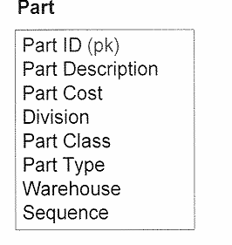
Smart Code - Resolution
Smart codes are usually holdovers from legacy systems and should not be used as primary keys.
Replace the smart code with an appropriate primary key and model individual elements of the smart code.
Create system generated identifier
Decompose multi valued attributes

Slide 12
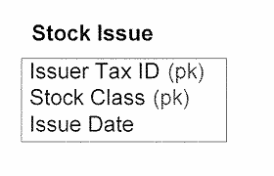
Compound Primary Key
A compound primary key is a primary key that is composed of two or more identifying attributes.
All attributes in a compound primary key are needed to uniquely identify an occurrence.

Slide 13
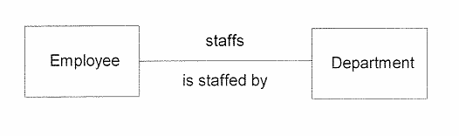
Relationship – Definition & Example
A relationship represents a direct business rule or association between two entity types.
A relationship is modeled using a line drawn between two entity types.

Slide 14
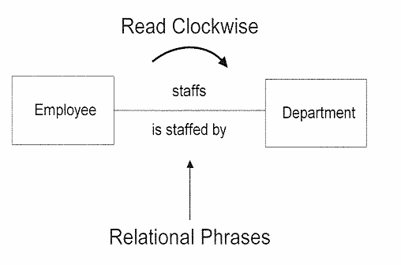
Relationship Phrase Example
Each relationship has two phrases.
The relationship phrase is read clockwise around a relationship.
The phrase provides meaningful context to the relationship and must reflect the nature of the association between entity types in business terms.

Slide 15
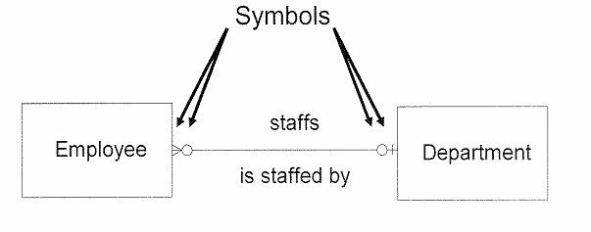
Relationship Cardinality
Cardinality expresses the minimum and maximum number of related occurrences between two related entity types.
It is defined by the symbols used at the both ends of the relationship line.

Slide 16
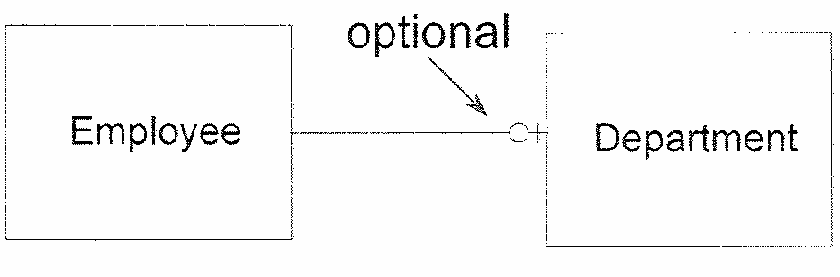
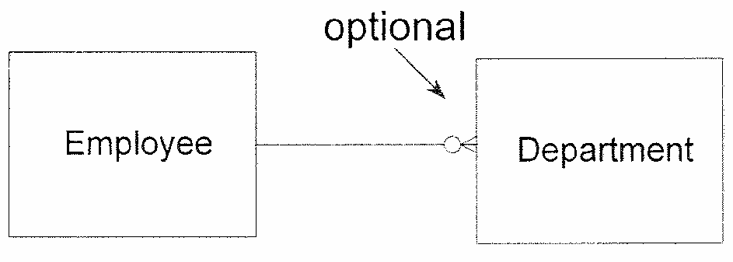
Relationship Optionality
Zero or one occurrence of Dept per Employee
Zero, one or many occurrence of Dept per Employee
Optionality expresses the minimum number of occurrences that may be related to one another.
If it appears on the relationship line, it means that the minimum number of related occurrences is zero (i.e. the relationship is optional).
If it does not appear, it means the relationship is mandatory.

Slide 17
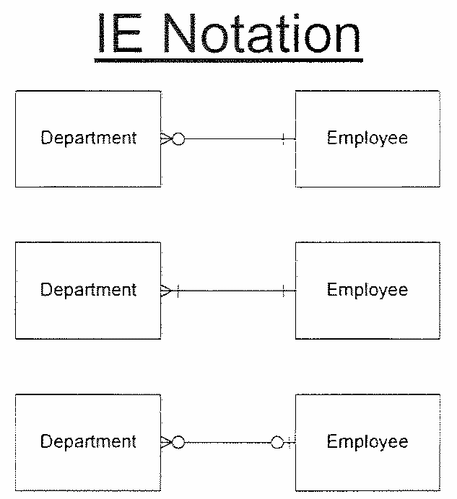
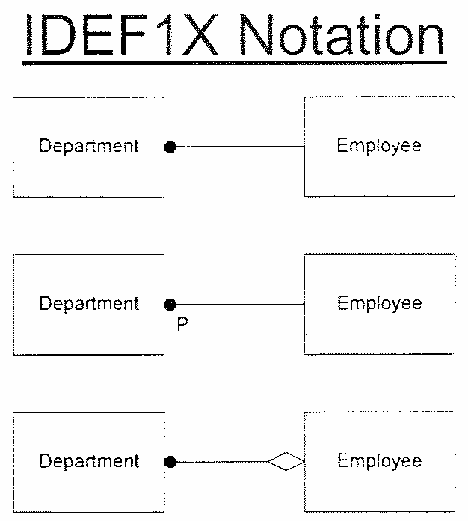
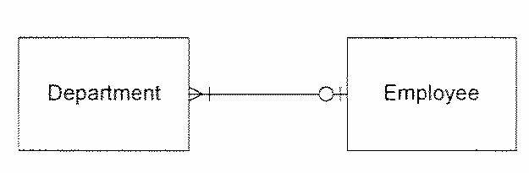
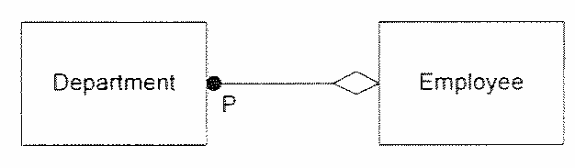
Relationship Notations-Information Engineering (IE) & IDEF1X
Integrated Definition for Information Modeling (IDEFIX) is a different notation developed by the federal government and supported by several modeling tools.
While the notation looks quite different, the above examples show the equivalent translation.

Slide 18
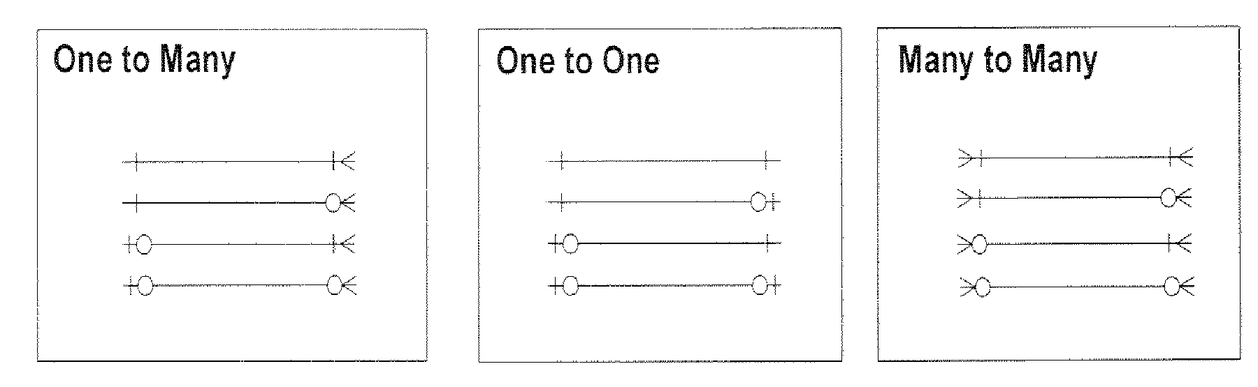
Relationship Types
With only two symbols for cardinality and one symbol for optional, all of the possible combinations are represented in the above categories.
The categories are based on the maximum symbol at both ends of the relationship as one-to-many(1:M),one-to-one(1:1),many-to-many(M:M).

Slide 19
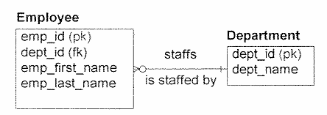
Foreign Key – Definition & Example
To implement a relationship between two entity types, the primary key of one entity type is copied to the related entity type.
The migrating primary key is called a Foreign key in the entity type to which it migrates.
Foreign keys are marked with “(fk)”.

Slide 20
Foreign Key Rules
One-to-many relationships-migrate the entire primary key from the one side to the many side.
One-to-one relationships-migrate the entire primary key from the mandatory side to the optional side.
Many-to-many relationships-resolve the relationship first then migrate.

Slide 21
Data Modeling in Data warehouse
Notes:
Data modeling follows its own terms and concepts. These terms and concepts are for storing the data in a meaningful way so that the data extraction and data manipulation becomes easy, transparent and manageable. This also helps in extension of data model to incorporate new process in it. Suppose that a company has an enterprise data warehouse and two data marts developed from it. A third data mart can be easily integrated into the system because it will pick up the data from the structured and organized data warehouse.
In part 2 under Data modeling terms and concepts, the entity type, attribute and metadata had been already explained.
So here, shall focus more on the relationship, primary key and foreign key concepts.
© 2009 Wipro Ltd – Internal & Restricted
‹#›

Slide 22
Data Modeling In DWH Environment
A DWH Environment
Involves multiple (viz. source, staging & target) layers of data storages.
Each layer has unique data modeling requirements.
S1
Data Mart
Data
Warehouse
Staging
OLAP
S2
Data Mart
S3
Reports
Notes:
A data model is composed of three basic constructs: entity types, attributes and relationships.
As a recap on Entity type and attribute: An entity type is a type of person, place, thing, concept or event which an organization must manage and for which data is stored.
Examples of entity types include those of customer, employee, location, order, vendor, part etc.
An attribute is a characteristic that describes an entity type and is typically expressed as a noun qualified by an adjective. The Employee type has Employee id and employee surname as attributes.
The relationship shows the relation between two entity types. It also represents the business rule.
The department has employees or Employee belong to a department form the relationship between Employee and Department.

Slide 23
Data Modeling In DWH Environment
Data Modeling Approaches
Entity Relational approach
Traditional modeling technique (more normalized)
Technique of choice for OLTP
Suits for corporate data Warehouse
Goals
Eliminate redundancy
Transaction efficiency
Dimensional Approach
Analyzing business measures in the specific business context (using STAR schema)
Helps visualize very abstract business questions
End users can easily understand and navigate the data structure
Goals
Query performance
Ease of understanding /Use

Slide 24
Module Summary
Congratulations! You have now completed the 3rd and final part of the module “Data Model Concepts”
You should now be able
To understand the terms and concepts of Data Models.
To understand the Primary key, Foreign Key
To understand Relationships
To understand the DWH environment

Slide 25
Quiz

Slide 26
Question 1
Which is not the feature of primary key
It can contain null value
It uniquely defines a record
An entity set can have only one primary key
Primary key can be combination of multiple attributes

Slide 27
Question 1
Which is not the feature of primary key
It can contain null value
It uniquely defines a record
An entity set can have only one primary key
Primary key can be combination of multiple attributes
Answer: A

Slide 28
Question 2
Which is not the correct statement for foreign key rule
One-to-many relationships-migrate the entire primary key from the one side to the many side
One-to-one relationships-migrate the entire primary key from the mandatory side to the optional side
Many-to-many relationships-resolve the relationship first then migrate
Many-to-many relationships- relationships-migrate the entire primary key from the mandatory side to the optional side

Slide 29
Question 2
Which is not the correct statement for foreign key rule
One-to-many relationships-migrate the entire primary key from the one side to the many side
One-to-one relationships-migrate the entire primary key from the mandatory side to the optional side
Many-to-many relationships-resolve the relationship first then migrate
Many-to-many relationships- relationships-migrate the entire primary key from the mandatory side to the optional side
Answer: D

Slide 30
Question 3
Which is not part of relationship definition
It has relationship phrase
It has relationship link
It has relationship cardinality
It has relationship option/participation

Slide 31
Question 3
Which is not part of relationship definition
It has relationship phrase
It has relationship link
It has relationship cardinality
It has relationship option/participation
Answer: B

Slide 32
Question 4
Following Employee and dept relation of a company is depicted as
Employee may belong to only one dept of the company or may not belong to any dept. The dept can have multiple employee
Employee belong to multiple dept. The dept can have multiple employee
Employee belong to only one dept. Dept can have multiple employee
Employee belong to only one dept, dept has only one employee.
Employee
Dept

Slide 33
Question 4
Following Employee and dept relation of a company is depicted as
Employee may belong to only one dept of the company or may not belong to any dept. The dept can have multiple employee
Employee belong to multiple dept. The dept can have multiple employee
Employee belong to only one dept. Dept can have multiple employee
Employee belong to only one dept, dept has only one employee.
Answer: A
Employee
Dept

Slide 34
Question 5
In Data Warehouse environment which of the following is not included
Staging Area
Transaction Processing (OLTP)
Enterprise Data Warehouse
Data Mart

Slide 35
Question 5
In Data Warehouse environment which of the following is not included
Staging Area
Transaction Processing (OLTP)
Enterprise Data Warehouse
Data Mart
Answer: B

Slide 36
References

Slide 37
References
Publications
Courses
Course structure was conceptualized from Business Data Modeling training course offered by Inteq Group
Fundamentals of Database Systems by R Elmasri, S Navathe, Publisher - Addison Wesley
DWH Concepts
URL’s
Training Programs
www.learndatamodeling.com
www.agiledata.org
Wipro Data warehousing Training Material

Slide 38
Thank You
Anand Kumar
Project Lead
Anand.akumar@wipro.com

